Slide 1
Module IV.3
Understanding NAP Implementation
Trainer: [Name]

Slide 2
Overview of this module
  How NAP technical guidelines define the NAP process
  The difference between NAP formulation and NAP implementation
  Case study: building community resilience to flooding in Malawi
  Reflection space: what makes effective NAP implementation

Slide 3
What can you expect to learn from this session?
The importance of bridging top-down and bottom-up approaches
Distinguish clearly between activities that count towards the formulation of a NAP process vs. activities that count towards its implementation
Ability to hold more informed dialogue with colleagues about NAP implementation in your country

Slide 4


From adaptation planning to implementation
Many countries face challenges in moving from the formulation of adaptation strategies and plans....
....to their actual implementation

Slide 5
Reflection time:
NAP formulation versus NAP implementation:
What is the difference?
Notes:
This slide is to provide a brief space for participants to think about what NAP implementation actually means. The NAP guidelines are a little vague on this, tending towards defining NAP implementation as a policy process (consensus, coordination, analysis, prioritization, design of strategies and activities…) while many might define implementation in more concrete terms, in effect the ultimate result of a policy process leading to the allocation of resources that make a visible difference to actors on the ground. This confusion needs to be clarified …

Slide 6
What do the LEG guidelines say about the NAP?
A “policy process” that
Facilitates inter-agency coordination, cross-sectoral planning, risk and vulnerability assessments, capacity-building efforts and identification and ranking of national priorities
Reduces vulnerability to the impacts of climate change, by building adaptive capacity and resilience
NAP Technical Guidelines, 2012
Notes:
The UNFCCC NAP Technical Guidelines defines the NAP as a policy process (coordination, analysis, consensus, prioritisation) leading to full integration of adaptation into national planning and budgeting (bullet point 1). NAP roadmaps can be used to guide this process. The end result of the NAP process entails also building capacity and resilience on the ground so as to reduce vulnerability to the impacts of climate change (bullet point 2).

Slide 7
The NAP process should be informed by ...
Top-down
Bottom-up
BOTH approaches are desirable and encouraged
Notes:
How can we effectively implement NAP? The NAP process can be guided by two approaches:
Top-down: adaptation actions are prioritized within national planning goals and objectives (e.g. NAP process);
Bottom-up: adaptation activities which are designed by communities to strengthen resilience.
NAP Technical Guidelines suggest that for an effective NAP process the two approaches should be integrated.

Slide 8


An example of complementary approaches in climate information management:
Top-down tool: climate change projections downscaled to regional or sub-regional levels, accompanied by expert opinion
COUPLED BY
Bottom-up approach: affected people examine own vulnerabilities, through participatory mapping, and relevant adaptation options
IPCC, 2014
Source: UN Photo, 2011
Source: UN Photo, 2012
Notes:
Bringing these two groups together is a form of NAP implementation. Letting them continue to work separately would not be defined as NAP implementation, since communities are not made more resilient. NAP implementation therefore means bridging the top-down (e.g. NAP Roadmap) with bottom-up approaches (activities on the ground aimed at stregthening people‘s resilience).

Slide 9
Gender considerations in implementation
Provide guidance to ensure gender mainstreamed from local to national levels in all NAP-related programmes and projects related;
Scale up current gender and adaptation actions/projects to inform policy level.
Use a gender expertise list (government, NGOs, research organizations, academic institutions, private sector), to support integration at all levels;
Involve stakeholders working on gender equality across different sectors;
Work to ensure gender balance in staffing (mechanisms to support to families, mobility, job announcements, etc.);
Make gender integration a prerequisite for government funding approval.
Source: IUCN 2011 Draft Guidelines to Mainstreaming Gender in the Development of National Adaptation Plans (NAPs)
Notes:
Mainstreaming gender in implementation means addressing/incorporating the perspectives, knowledge, needs, concerns and challenges of women, as well as men, at community level as well as through national planning and policy. This also should include considering other variables such as age (e.g. youth) and others such as socio-economic grouping). All sectors will see improved adaptation efforts with gender mainstreaming throughout. It is important to engage men in the discussions around gender and adaptation to ensure adaptation efforts will benefit both women and men, their households and communities.
Draw lessons learned from projects (smaller scale and larger investments) and analyse enabling conditions to be scaled up and replicated through policy. For example, IFAD’s Adaptation for Smallholder Agriculture Programme active in a number of countries across different regions. Uganda’s PRELNOR (with ASAP grant along with other funding) integrating a gender approach which focuses on building resilient households and communities through applying the Gender Action Learning Systems (GALS) approach and household mentoring methodology. This builds on experience gained under other initiatives in Uganda.
Keep a list of gender experts on hand to help streamline efforts to mainstream gender (e.g. conducting a gender analysis, designing data collection instruments, data collection, gender-responsive participatory approaches, etc.. This could include gender experts/organizations including from government bodies, NGOs, research institutes, universities, private sector, etc.
Ensure stakeholders working on gender-related issues are included at different levels. It is important to consider different sectors from energy, transport, water, health, and agriculture, to name a few. International organizations/networks such as Global Gender and Climate Alliance (GGCA) cover a number of sectors and are connected to numerous national networks and organizations. ENERGIA has links to the renewable /green energy sector in many countries.
Not only is it important to include gender considerations in programming, but also in organizational mechanisms to smooth adaptation efforts. This means finding ways to support both women and men in their jobs – including flex time, mobility considerations for women and their families, trying to put spouses in a similar district in the country, etc. Job announcements may also need to be included in non-traditional channels – women may have some different professional networks with which they share information.
Finally, gender budgeting can also ensure that government funding approval is dependent on gender integration in any projects and initiatives.

Slide 10
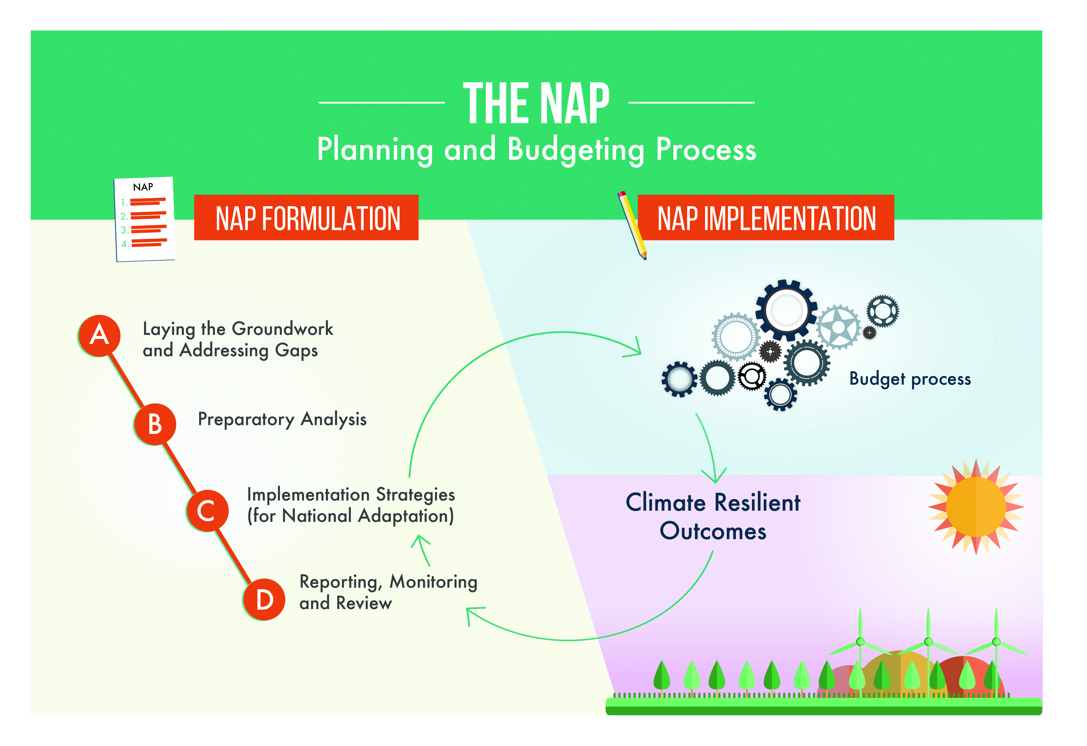
NAP Formulation vs. NAP Implementation
Source: UNITAR, 2016
Notes:
NAP formulation is the process by which countries get to the point of integrating adaptation into planning strategies (the end result of Element A and B of NAP Technical Guidelines). This involves policy and organizational work. NAP implementation means visible investments being designed and executed to strengthen the resilience of vulnerable people and communities. This entails budget programming and execution, and implementation on the ground, with the final delivery of climate resilient outcomes. NAP Technical Guidelines provide detailed indications on how to reach the formulation (see Element A and B) and implementation level (Element C).
Specifically, Element C of the Technical Guidelines is concerned with the design of implementation strategies of the national adaptation plans. The main outputs of Element C should be the design of: 1) strategy for implementing the NAPs and 2) concrete activities to implement priorities identified in the NAPs. The implementation of concrete activities can only be realized if national adaptation priorities are integrated into national budgetary processes (see the graphic and next slide). The results achieved through adaptation implementation would then need to be continuously monitored so as to allow the NAP process to be revised and adjusted (see Element D on Reporting, Monitoring and Review).
This is in line with what indicated by the latest Paris Agreement where it is stressed the need to link the NAP to “implementation of policies, projects, and programmes” as follows:
CP21/47 47. Further requests the Green Climate Fund to expedite support for the least developed countries and other developing country Parties for the formulation of national adaptation plans, consistent with decisions 1/CP.16 and 5/CP.17, and for the subsequent implementation of policies, projects and programmes identified by them.

Slide 11
From formulation to implementation
Elements A and B of NAP Technical Guidelines
Strategic planning
Budget preparation
Budget execution
Accounting and monitoring
Report and audit
Policy review
Element D of NAP Technical Guidelines
The budget cycle
Element C of NAP Technical Guidelines
Element D of NAP Technical Guidelines
Notes:
In order to be implemented, national adaptation priorities should be integrated into the existing national budget process.
The budget process is usually driven by a longer term planning annual cycle. The budget cycle consists of 6 phases: strategic planning, budget preparation, budget execution, accounting and monitoring, reporting and audit, policy review. The budget preparation phase is particularly important because planning and budget specialists make decisions that will affect future national performance. It is at this point that NAP focal points may determine how to link national adaptation priorities to specific investments on the ground.
When preparing the national budget, Ministries of Finance will determine the total resource envelope for a particular year and then allocate that ‘budget’ to different sectors, such as health, education, energy, and transportation, depending on national development (and adaptation) priorities. They will also consider allocations to different levels of government, central, regional and local. Budget allocation and implementation is followed by monitoring and reporting, over recurrent annual cycles.

Slide 12
Exercise/Case study:
Identifying NAP implementation challenges
Notes:
This exercise is based on a real case study on NAP implementation challenges in Malawi, specifically in relation to community resilience to flood events.

Slide 13

A case study on NAP implementation challenges (the baseline)
Source: Finnish Red Cross, 2014
Notes:
This case study tells the story of how a community in Malawi is dealing with increasing flooding due to climate change. This is evidence of the need of NAP implementation on the ground. In Malawi, adaptation planning processes were happening, but they did not reach the communities. Top-down and bottom-up approaches have not been brought together. By analysing the case study there are lessons to be learned about the effectiveness of the NAP process.
Flood impacts in Malawi from climate change
There are some key messages
Policy level measure: national climate change programme decide to improve information for local level management risk
Organisation measure: design, financing and establishment of climate change info centres – 7 districts
Operational: the info centres did not work (ownership, accessibility, engagement, computer literacy, info too technical and top down, technical challenges with internet connection to update weather info)

Slide 14

Case study on NAP implementation challenges: the response
Climate Change Information Centres
Established (2012) through National Climate Change Programme
To disseminate daily and seasonal weather forecasts tailored to local needs
To provide local awareness
Source: UNDP Malawi, 2014
Notes:
Tailored: broken down by type of risk and location

Slide 15
Following an evaluation of the Climate Change Info Centres carried out in August 2014 by the government and UNDP, UNDP issued a Back to Office Report (BTOR).

Slide 16
Group work instructions (40 minutes):
Break into groups of 5 people
Individually read the BTOR (5 minutes)
Identify and highlight the key challenges to climate centres implementation
Within your group discuss the challenges and possible solutions by using Matrix A
Present your results in plenary

Slide 17
Matrix A for group work
Challenges | Possible solutions
1. Ownership | E.g. Engage with District Councils, local communities on the existence of the centres
2. Accessibility
3. Capacity building
4. Operational equipment
5. …..

Slide 18
A case study on NAP implementation challenges: issues raised
Ownership: engage with District Councils, local communities on the existence of the centres and on data collection;
Accessibility: relocate some of the centres to improve communities‘ accessibility;
Capacity building: training ad hoc personnel that can assist in the centres management and operation;
Operational equipment: supply hardware and software equipment as to connect centres to Met stations.
BTOR evaluation of climate change information centres (August 2014)

Slide 19
Reflection space
By using the Malawi example, try to see whether a truly top down and bottom up approach was applied. What happened in this case? Where the pitfalls can be located?
What can be learned about the interplay between NAP formulation and implementation phases?
What can be done to ensure the effective delivery of adaptation results on the ground?
Can you provide an example of top-down, bottom-up or integrated adaptation approach from your country experience?

Slide 20
What have we learned?
  The NAP process entails different steps
  NAP technical guidelines provide detailed guidance on how to develop a NAP Roadmap
  Interplay and linkages between levels as well as combing top-down and bottom-up approaches are essential
Monitoring and evaluation is fundamental to support effectiveness

Slide 21
Imprint
Published by
Deutsche Gesellschaft für
Internationale Zusammenarbeit (GIZ) GmbH
Climate Policy Support Project
Dag-Hammarskjöld-Weg 1-5
65760 Eschborn, Germany
T +49 61 96 79-0
F +49 61 96 79-1115
Contact
E climate@giz.de
I www.giz.de/climate
Responsible
Michael Brossmann, GIZ
Authors
Angus Mackay, Ilaria Gallo
Photo credits
Title: Top-down (UN Photo, 2011), Bottom-up (UN Photo, 2012), The NAP Planning and Budgeting Process (UNITAR, 2016), Classroom (UNDP Malawi, 2014)
This presentation is part of a NAP country-level training that has been developed by GIZ on behalf of BMZ
and in cooperation with the NAP Global Support Programme (NAP-GSP), in particular UNDP and UNITAR.
The training is designed to support countries in setting up a National Adaptation Plan (NAP) process. It builds on the NAP Technical Guidelines developed by the Least-Developed Countries Expert Group (LEG).
You are welcome to use the slides, as long as you do not alter its content or design (including the logos), nor this imprint. If you have any questions regarding the training, please contact Michael Brossmann at GIZ.
For questions related to the Technical Guidelines, please refer to the UNFCCC’s NAP Central.
As a federally owned enterprise, the Deutsche Gesellschaft für Internationale Zusammenarbeit (GIZ) GmbH supports the German Government in achieving its objectives in the field of international cooperation for sustainable development. GIZ also engages in human resource development, advanced training and dialogue.

