Slide 1
Module III.2
Develop and select adaptation options
Trainer: [Name]

Slide 2
Overview of this module
  Why do we select between different options and why it is necessary to quantify the costs of adaptation options
  Different assessment approaches:
    Cost-benefit analysis
    Cost-efficiency analysis
    Multi-criteria analysis
  Take-away messages

Slide 3
What can you expect to learn from this session?
Understand the necessity of prioritising adaptation options
Get introduced to different methods that support decision-making
Apply criteria for prioritization

Slide 4


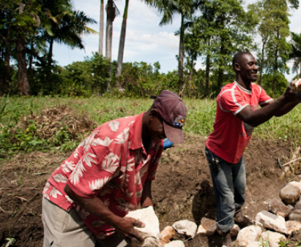

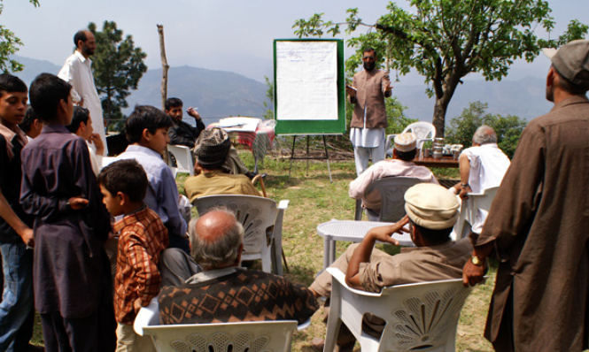
What are adaptation options?
Research
Policy
Technical solutions
No-/low-regret options
Capacity development
Source: All adopted from GIZ, 2014
Notes:
Yesterday we already heard about adaptation options. Do you remember?
Policy, Good practices Technical solutions, Research Capacity Development.
Manage threats: e.g. Management of dams and digs
Prevent/impede impacts: e.g. By applying redistribution mechanisms for water in case or in times of scarcity
Change/improve uses : z.B. adapted agricultural crops and drought resistant crops
Change environment: z.B. resettlement, relocation
Distribute losses: z.B. by insurance and reinsurances
Capacity development: z.B. information campaign, trainings, etc.
Quellen
Forschung: http://polpix.sueddeutsche.com/polopoly_fs/1.1107109.1307633051!/image/image.jpg_gen/derivatives/900x600/image.jpg
Nutzung ändern: http://www.boelw.de/uploads/pics/biofrage_27.jpg
Bedrohung ändern: http://www.brot-fuer-die-welt.de/images/content/bangladesch/bangladesch_aktiv-gegen-den-klimawandel.jpg
Auswirkungen verhindern: http://www.kfw-entwicklungsbank.de/ebank/DE_Home/Laender_und_Programme/Lateinamerika/Bolivien/Leuchtturmprojekt_1.jsp
Informationskampagnen:

Slide 5
Why is it necessary to select/prioritize among adaptation options?
  Limited resources for implementation
    Financial means, time, institutional capacities, people, etc.
  Lack of knowledge on scope of investment
  To know how much has to be invested, when it should be invested and whether options are economically viable
  → Selection or prioritization needs dialogue for everybody to accept the results.
  → Agreed criteria assist the process.
Notes:
Now, looking at our previous discussion. As you have seen, there are a lot of different ways to adapt to chanes in climate.
In your experience, would it be possible to implemented all adaptation measures?
We know that many sectors and activities in the sectors are affected by climate change
We also know that adaptation to climate change also competes with other topics on the policy agenda.
I think it is clear for everybody that not all of the different adaptation options could be implemented.
What are main reasons, that you won‘t be able to implement all?
From your experience, what do you think are the reasons why we have to select among the options or prioritize?
Refer to NAP process and/or Technical Guidelines.
Adaptation to CC is an investment facing limited resources. The objective of such an investment would be to create the highest benefit within a given project.
Transparency: why was this specific option selected (and not others), to communicate the efforts in the field of CC adaptation
Accountability: towards donors who invest money into adaptation; for the use in M&E systems
Background information on economics of climate change:
The Stern Report (2006):
Costs from CC: 5-20% GDP loss per year, now and in the future
The benefits of strong, early action on climate protection considerably outweigh the costs (1% GDP/year).
Important: not all effects of CC can be measured in terms of costs!

Slide 6
Possible criteria for selecting and prioritizing adaptation options
  Effectiveness
  Costs
  Feasibility
  Gender-sensitivity, gender responsiveness
  Urgency of taking action
  No regret measures
  Political and social acceptance
  Alignment with funding requirements
  Biodiversity friendliness
What would be important to you?
Notes:
» Criteria: refer to box in Training Manual of OECD Training for more criteria
Make sure that all people have a good understanding of the terms → refer to Glossary!
Effectiveness: the extent to which the adaptation measure reduces vulnerability and provides other benefits.
Cost: includes investment cost as well as cost over time such as operation and maintenance costs, reconstruction costs etc..
Feasibility: answers the question, whether the necessary legal, administrative, financial, technical etc. resources exist. Adaptations that can be implemented under the current operational framework will usually be favoured.
Gender responsiveness means that adaptation options have considered, and respond to, the different lived realities, perspectives, experiences, needs, and constraints of women and men.
There are different decision support tools!
I will present then to you briefly.

Slide 7
Decision support tools
Cost-benefit Analysis (CBA)
Cost-efficiency Analysis (CEA)
Multi-criteria Analysis (MCA)

Slide 8
Cost-benefit Analysis (CBA) – Overview
= Basically the comparison of the costs and benefits of a project
Advantages
  Informs on economic viability of an adaptation option
  Allows for prioritisation between alternative adaptation options in monetary terms
Limitations
  Costs and benefits must be measureable in monetary terms

Slide 9
Cost-efficiency Analysis (CEA) – Overview
= Cost analysis of alternative adaptation options
Compared with CBA, only suitable where benefits cannot be defined in monetary terms
Advantages
  Gives information on how an objective can be achieved in the most efficient way
Limitations
  Measurable objective required
  Costs need to be defined in monetary terms

Slide 10
Multi-criteria Analysis (MCA) - Overview
= Tool that is able to rank and prioritize multiple adaptation options.
Ranks resulting from an MCA are not based purely on economic calculations but on a qualitative assessment of criteria.
Advantages
  MCA allows for prioritization and helps identify trade-offs and win-win situations!
  Need to find a common indicator (e.g. scores)
  → scores can be calculated (if quantitative judgment is available)
  → or be obtained via expert consultation
Limitations
  MCA is more subjective than other methods
  MCA tells nothing about economic efficiency

Slide 11
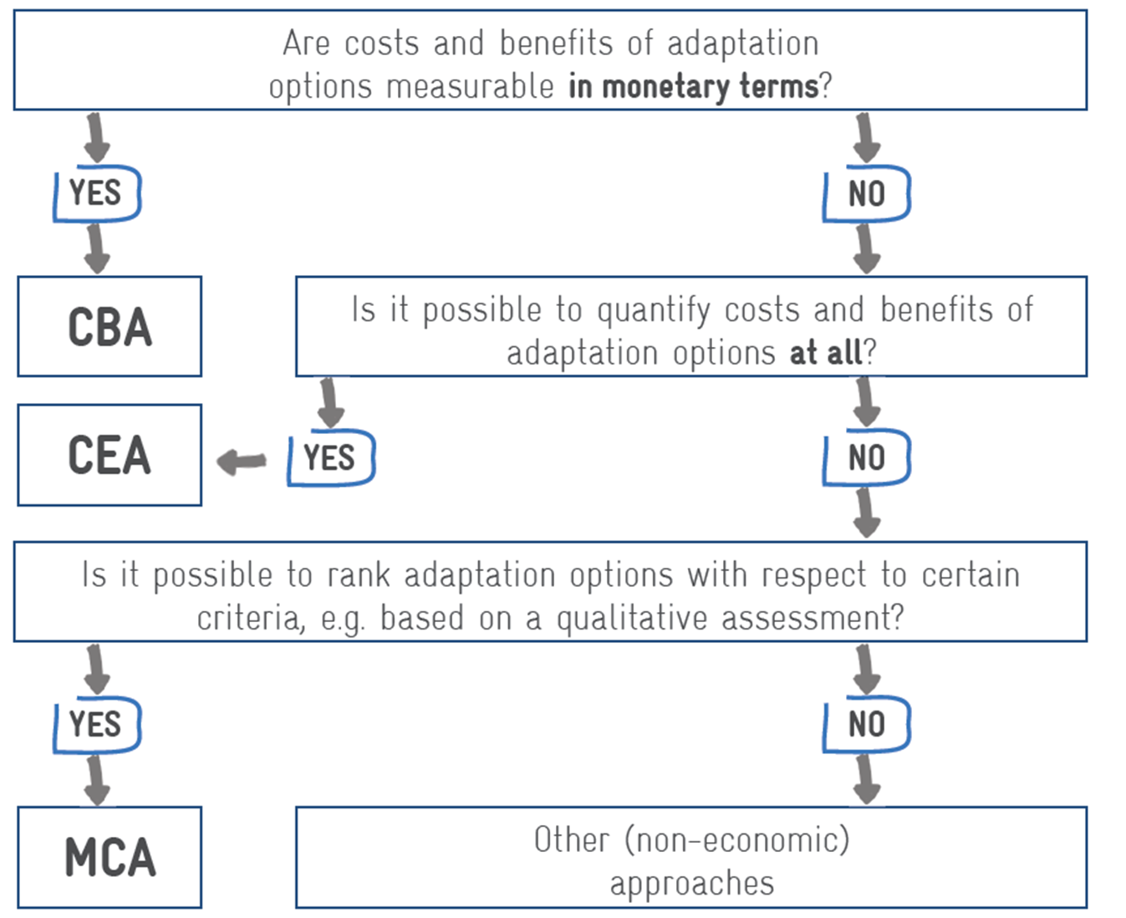
Selecting a method for assessing adaptation options
Is it possible to measure costs in monetary terms and quantify benefits at all?
CBA = Cost-benefit Analysis
CEA = Cost effectiveness Analysis
MCA = Multi-criteria Analysis
Source GIZ, 2013
Notes:
Use existing data!
» Criteria: refer to box in Training Manual for more criteria
Make sure that all people have a good understanding of the terms → refer to Glossary!
Effectiveness: the extent to which the adaptation measure reduces vulnerability and provides other benefits.
Cost: includes investment cost as well as cost over time such as operation and maintenance costs, reconstruction costs etc..
Feasibility: answers the question, whether the necessary legal, administrative, financial, technical etc. resources exist. Adaptations that can be implemented under the current operational framework will usually be favoured.

Slide 12
Multi-criteria analysis: an example from Mexico
The Special Programme on Climate Change establishes specific adaptation goals for sectorial ministries. Due to a lack of resources, projects need to be prioritised. MCA ensures that important criteria are met. It is used by four government bodies.
1
Establish the context
7
Calculate overall values
8
Examine and test results
2
3
4
5
6
Identify measures
Select criteria and indicators
Validate criteria and indicators
Assign a weight to each criterion
Score measures
Notes:
The Mexican Government’s long term vision regarding adaptation to climate change is manifested in the Climate Change Law, which was enacted in June 2012. The law gives special attention to adaptation to climate change, which allows for the formulation of policies in this field. As established in this legislation, the Mexican Government is responsible for formulating the National Climate Change Strategy (Estrategia Nacional del Cambio Climático, ENCC) as well as the second Special Programme on Climate Change (Programa Especial del Cambio Climático, PECC). The former aims to establish a framework for national climate change policies, programmes and actions, while the latter establishes specific goals for sectorial ministries relating to both adaptation and mitigation.
Other policies, programmes and projects within this policy framework will be designed, but due to a lack of human, technical and financial resources, not all will be implemented. The prioritisation of measures using an MCA approach ensures that important criteria are met and that decisions in favour of specific measures are harmonised.
The Ministry of Environment (SEMARNAT) has commissioned its independent bodies to carry out specific tasks: the National Water Commission (CONAGUA) is to implement the methodology for water policies, while the National Forestry Commission (CONAFOR) and the National Commission for Natural Protected Areas (CONANP) are to develop the prioritisation tool in the Forest Ecosystem sector. The ministry of Agriculture (SAGARPA) has also applied to prioritise adaptation measures in irrigated agriculture as a pilot sector.

Slide 13
Priority setting: gender considerations
Are adaptation options and priority setting based on:
  qualitative and quantitative data that genuinely reflects women’s needs and interests as well as men’s?
  disaggregated data that highlights women’s and men’s different needs, interests, challenges and felt impacts of CC?
Were organizations representing women, youth, social inclusion consulted during priority setting, e.g. Ministry of Women’s Affairs/Gender, NGOs, research organizations?
Adapted from: IUCN 2011 Draft Guidelines to Mainstreaming Gender in the Development of National Adaptation Plans (NAPs) United Nations Framework Convention on Climate Change (UNFCCC)
Notes:
Re: Disaggregated data, this may mean considering disaggregating by age group also as inclusion of youth (young women, men) are crucial to effective adaption.

Slide 14
Gender-responsive adaptation
Seeks to identify, redress existing, potential inequalities by ensuring women, as well as men, are engaged in all levels of climate change response.
  Based on comprehensive, participatory, gender-sensitive analysis.
  Recognizes differential vulnerability; targets adaptation strategies.
  Builds on existing knowledge and capacities.
  Planned, implemented with equitable participation.
  Promotes adaptation policies, programmes to meet needs of women, men
  Supports equitable access resources, rights, opportunities
  Consider outcomes vs outputs .
                Adapted from UNDP, 2015; CARE, 2010
Notes:
Source: CARE (2010) Adaptation, gender and women’s empowerment http://bit.ly/2aQspW4 ; UNDP (2015) Gender-responsive national communications toolkit http://bit.ly/2n3Po3N
Any CBA or multi-criteria analysis must also be considered from a social/gender perspective. What are the possible different implications for women, men of proposed option(s)?
Gender results from climate change adaptation project portfolio can also inform broader adaptation processes (e.g. UNDP- Canada CCAF Process) http://bit.ly/2fcIgNA
Differences between adaptation outcomes and outputs
Example from Mali UNDP-Canada CCAF Program http://bit.ly/2gxlMNg
Outcome 1: Capacities to prevent and manage the impacts of climate change on agricultural production and food security are improved
Outputs: Output 1.1: Analysis of economic impacts of climate change on the agricultural and food security sectors are conducted within the targeted municipalities
Output 1.2: Guidelines are elaborated and awareness-raising campaign and training workshops (targeting local decision makers) are conducted in order to promote the integration of adaptation considerations within rural development policies, plans and programmes at the local level
Output 1.3: Local adaptation financing strategies are established
Output 1.4: Technical structures supporting rural development are informed, trained and provided with the tools to support the implementation of adaptation measures in order to manage climate risks
Output 1.5: A strategy for the integration of adaptation considerations within national level agriculture- and food security-related laws, policies, plans and programmes is developed and implemented
Example from Cambodia (UNDP-Canada-CCAF Program http://bit.ly/2g6Bf1w
Outcome 2: Locally appropriate adaptation options demonstrated to reduce exposure to climate change induced risks ​Output 2.1: Improved rainwater harvesting demonstrated in 30 target villages
Output 2.2: Resilient farming methods to climate-induced changes in rainfall intensity and distribution demonstrated
Output 2.3: Resilient design and management of reservoirs, irrigation canals, ponds and dykes demonstrated

Slide 15
Take home messages
Adaptation options range from less to more costly!
Ensure transparency and validate results
Benefit from existing data and knowledge
Do not use too sophisticated tools if data is the problem
Make use of a proper mix of assessment tools, i.e. combine CBA and MCA
Tools are not an end in itself but means to achieve an objective
Ensure options equally take into account women’s and men’s needs, challenges, and opportunities
Notes:
For last point: Ensure options equally take into account needs and opportunities of women and men
Also ensure that benefits are equitably distributed among women and men.

Slide 16
Exercise: short version of a multi-criteria-analysis
You are invited to evaluate the feasibility of each action in matrix III.2.1
In this exercise, you will apply only the given criteria:
Know-how available;
cost intensity; and
political and social acceptance.
You will work in sub-groups
Notes:
In relation to political and social acceptance, consider that gender and social norms often impact what is acceptable or doable. Women and men may have different knowledge, experience, needs, and constraints that will determine what is or is not acceptable or feasible given their context. It is also important to consider under „social acceptance“ women‘s and men‘s different time/labour costs (and changes that may be incurred), impacts elsewhere in the household (will girls or boys‘ school attendance be impacted? How? What other spin-off effects might this cause if they have to leave school part-time or full-time?)

Slide 17
Imprint
Published by
Deutsche Gesellschaft für
Internationale Zusammenarbeit (GIZ) GmbH
Climate Policy Support Project
Dag-Hammarskjöld-Weg 1-5
65760 Eschborn, Germany
T +49 61 96 79-0
F +49 61 96 79-1115
Contact
E climate@giz.de
I www.giz.de/climate
Responsible
Michael Brossmann, GIZ
Authors
Nele Bünner, Annette Lutz
Photo credits
Title: Methods for selecting options (GIZ, 2013), Adaptation options (GIZ, 2014: Markus Kirchgessner, Britta Radike, Markus Kirchgessner, Florian Kopp)
This presentation is part of a NAP country-level training that has been developed by GIZ on behalf of BMZ
and in cooperation with the NAP Global Support Programme (NAP-GSP), in particular UNDP and UNITAR.
The training is designed to support countries in setting up a National Adaptation Plan (NAP) process. It builds on the NAP Technical Guidelines developed by the Least-Developed Countries Expert Group (LEG).
You are welcome to use the slides, as long as you do not alter its content or design (including the logos), nor this imprint. If you have any questions regarding the training, please contact Michael Brossmann at GIZ.
For questions related to the Technical Guidelines, please refer to the UNFCCC’s NAP Central.
As a federally owned enterprise, the Deutsche Gesellschaft für Internationale Zusammenarbeit (GIZ) GmbH supports the German Government in achieving its objectives in the field of international cooperation for sustainable development. GIZ also engages in human resource development, advanced training and dialogue.

