Slide 1
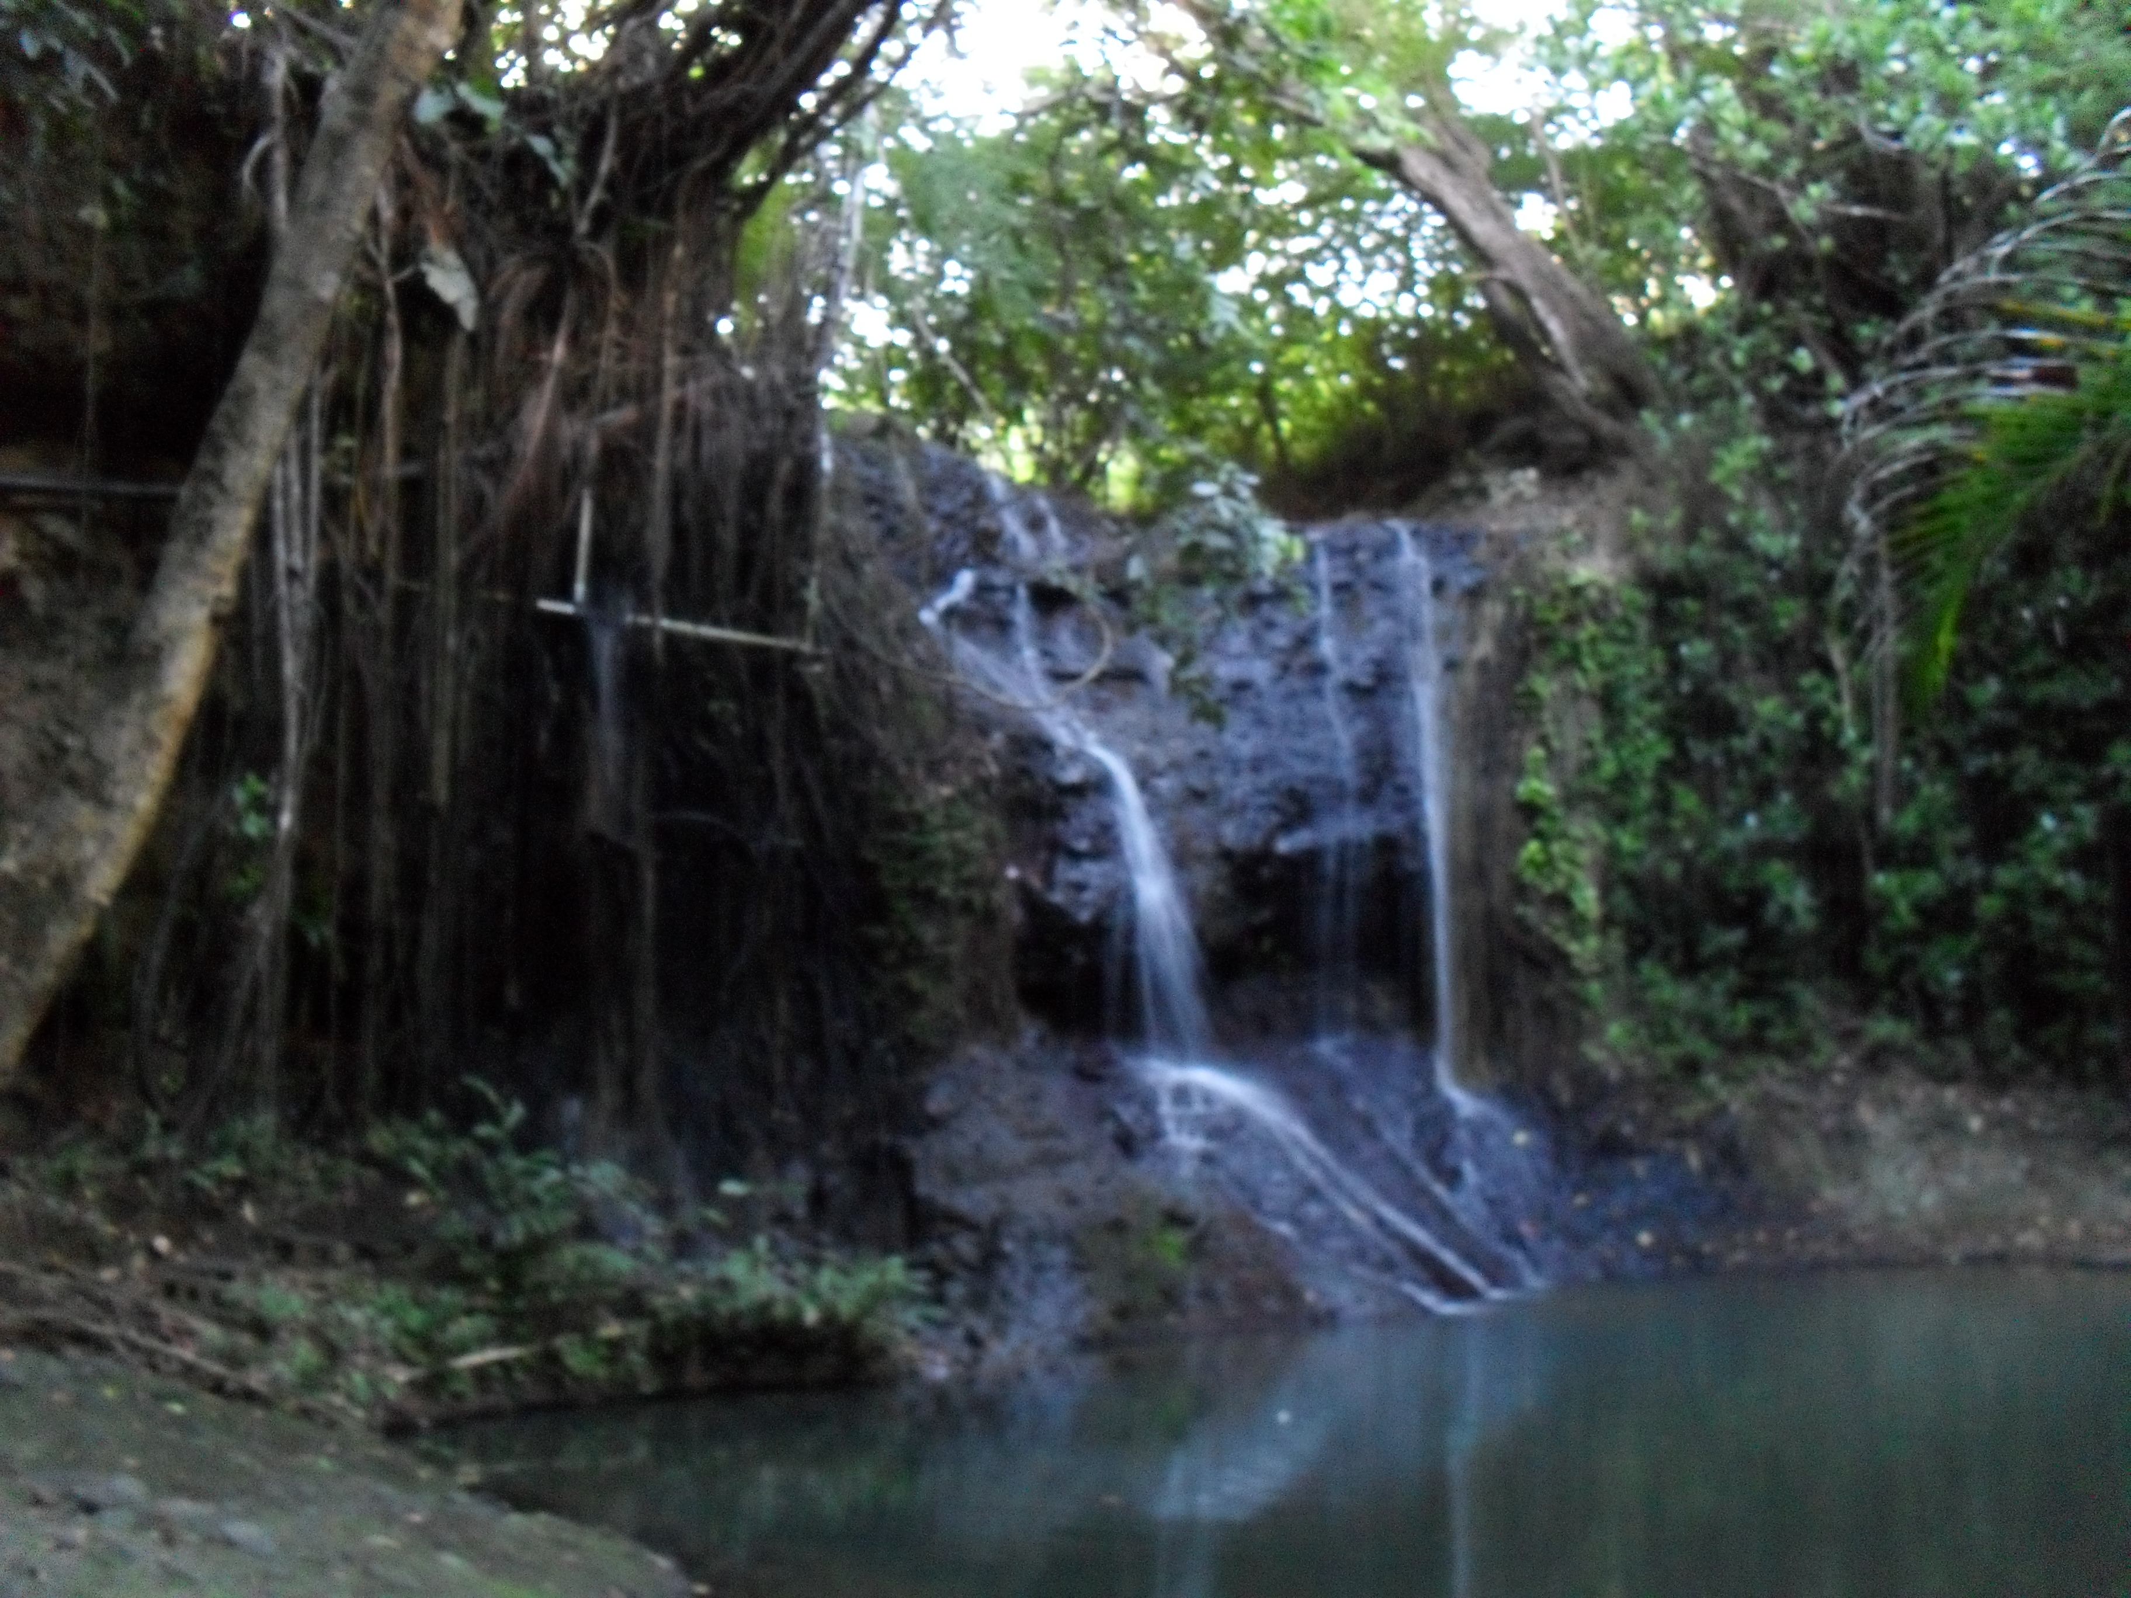
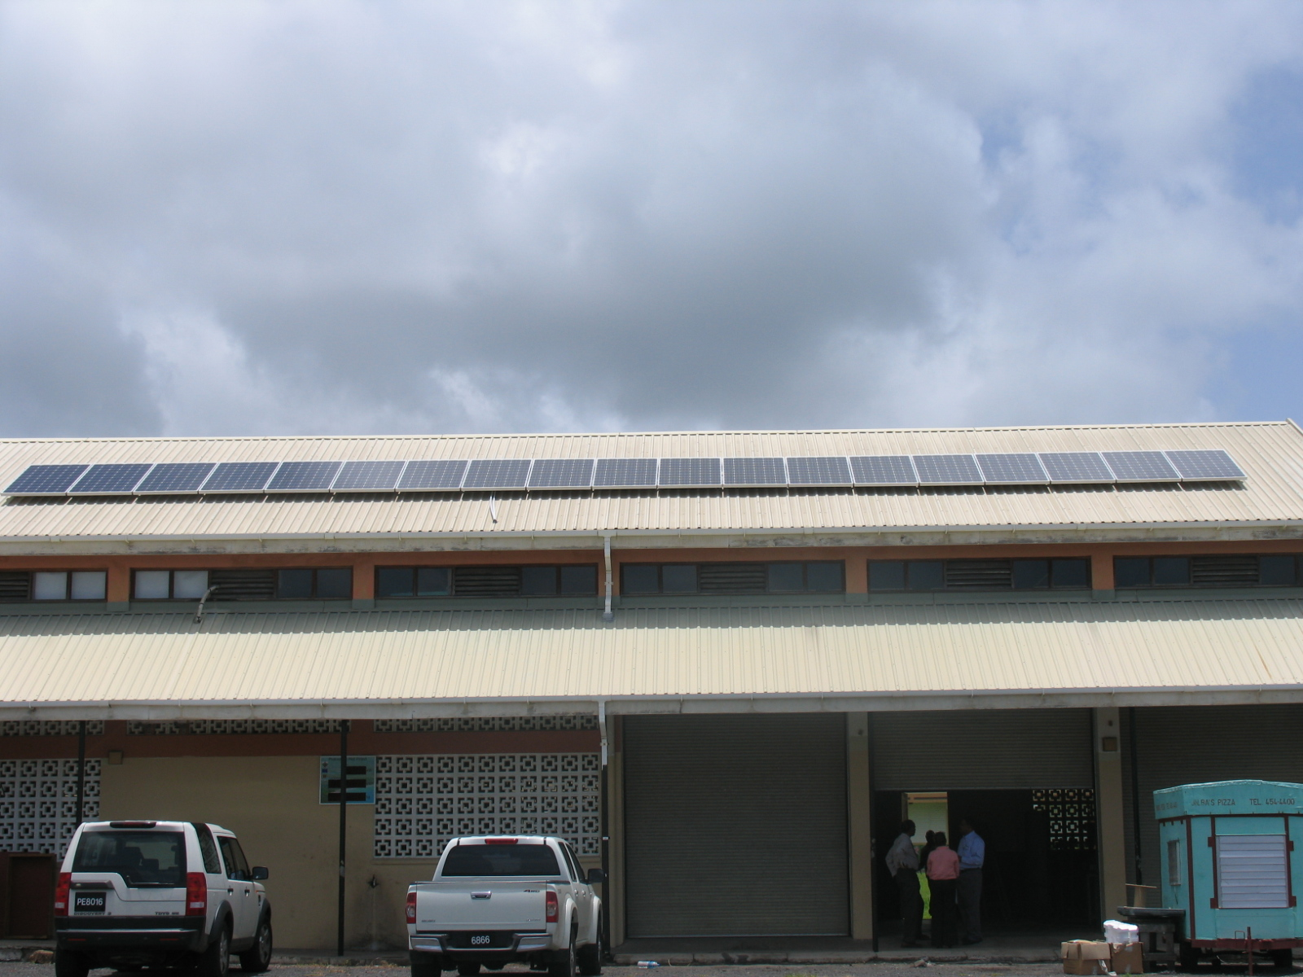
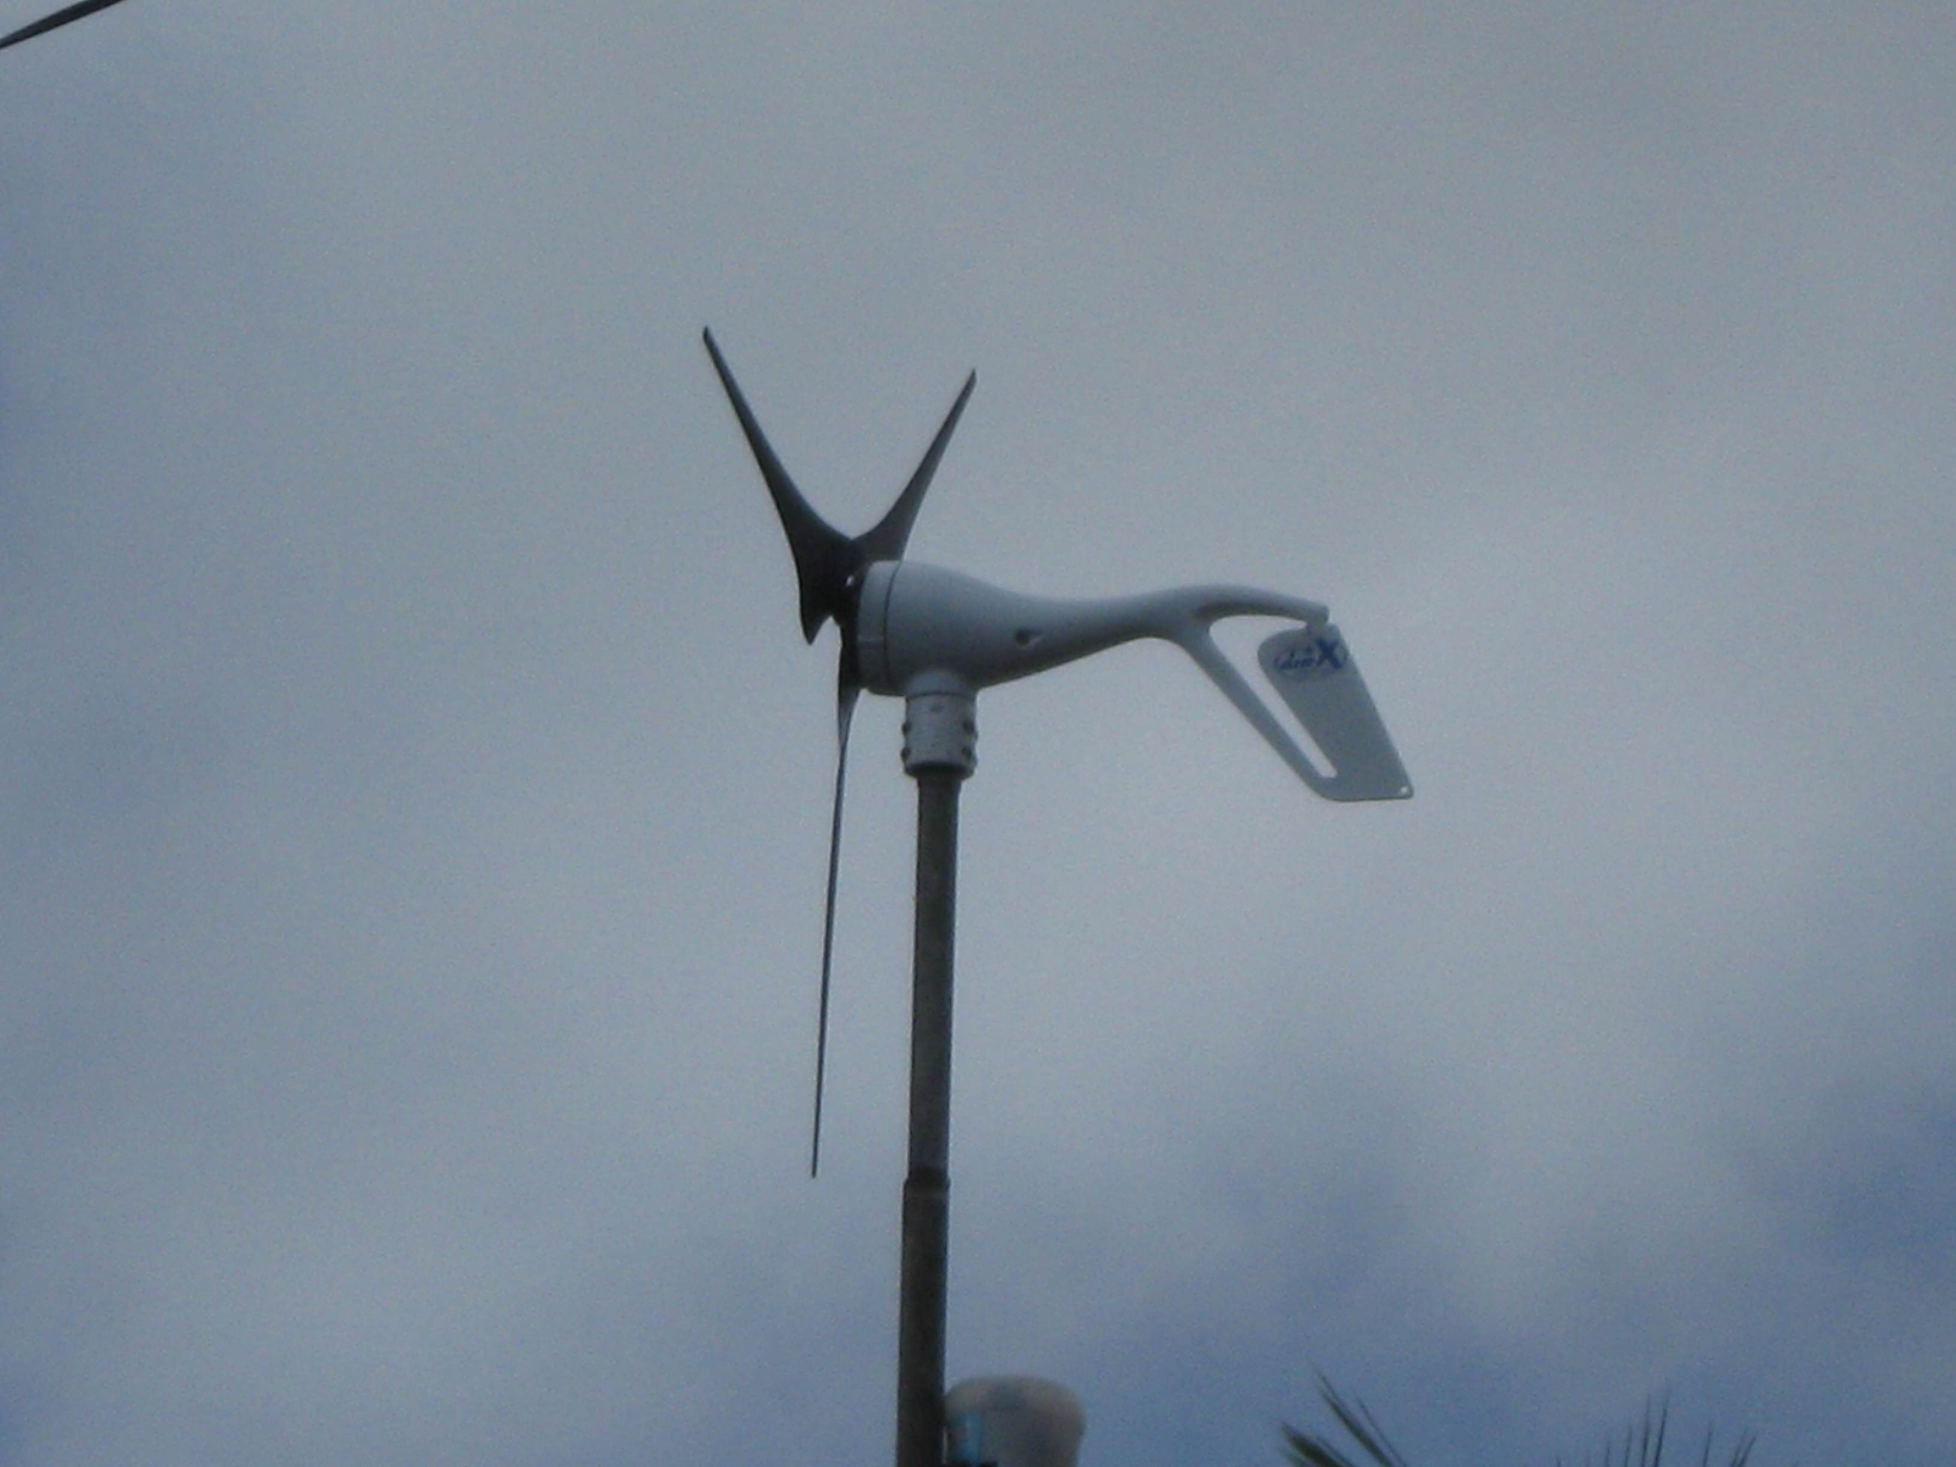
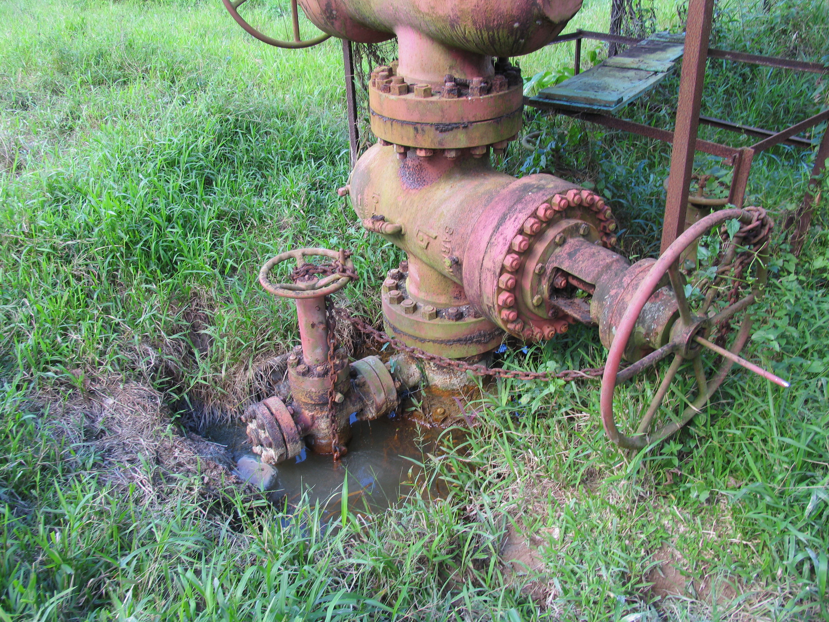
NATIONAL CONTEXT FOR MITIGATION ACTION

Slide 2
GREENHOUSE GAS ACCOUNTING & REPORTING
National Communications Process to the United nations Framework Convention on Climate Change (UNFCCC)
2000 GHG Inventory- INC
2005 GHG Inventory-SNC
2010 GHG Inventory-TNC
  NATIONAL ENERGY BALANCE DATABASE
  IRENA ENERGY BALANCE

Slide 3
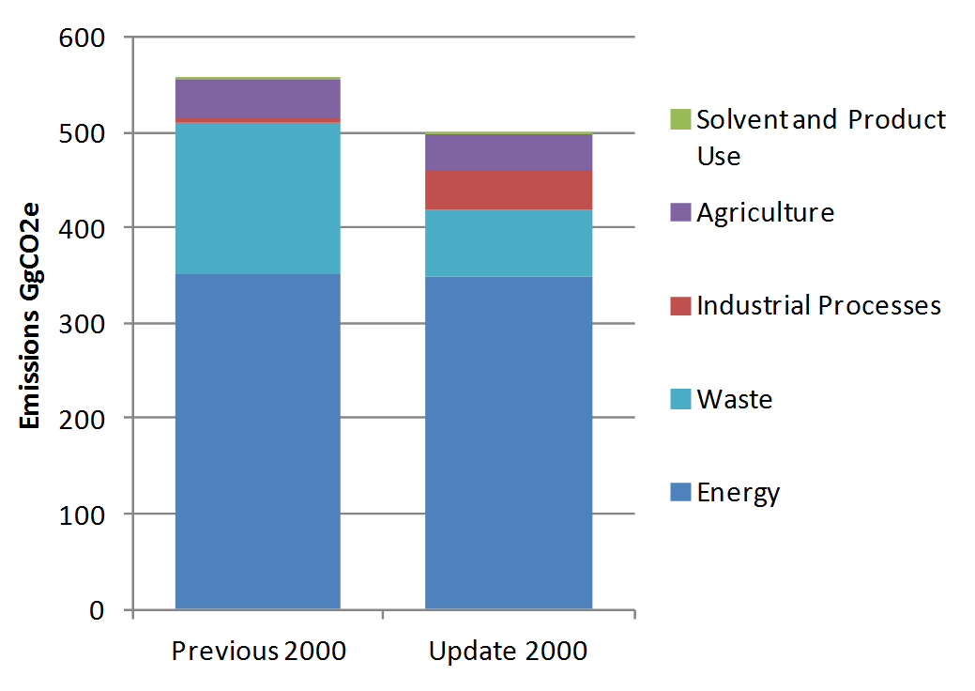
SUMMARY OF GHG FINDINGS
  Tier 2 Estimates for Methane Generation from Solid Waste Disposal (-57%)
  HFCs Consumption (+770%). Previous inventory didn’t estimate bulk emissions only product

Slide 4
SUMMARY OF GHG FINDINGS CONT’D
  Excludes contribution of LULUCF Sector (sink)
  Emissions dominated by Energy Sector (77%)
  Growth in energy sector 3.1% all other sectors 0.3%.

Slide 5
Translating into Mitigation Action

Slide 6
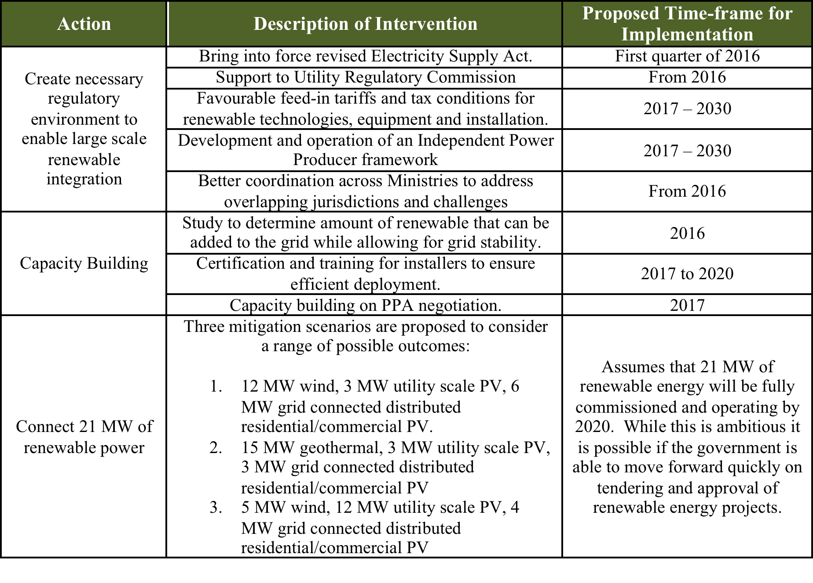
Table 41: Description of Interventions and timeframe for Implementation of 35% renewable energy target

Slide 7

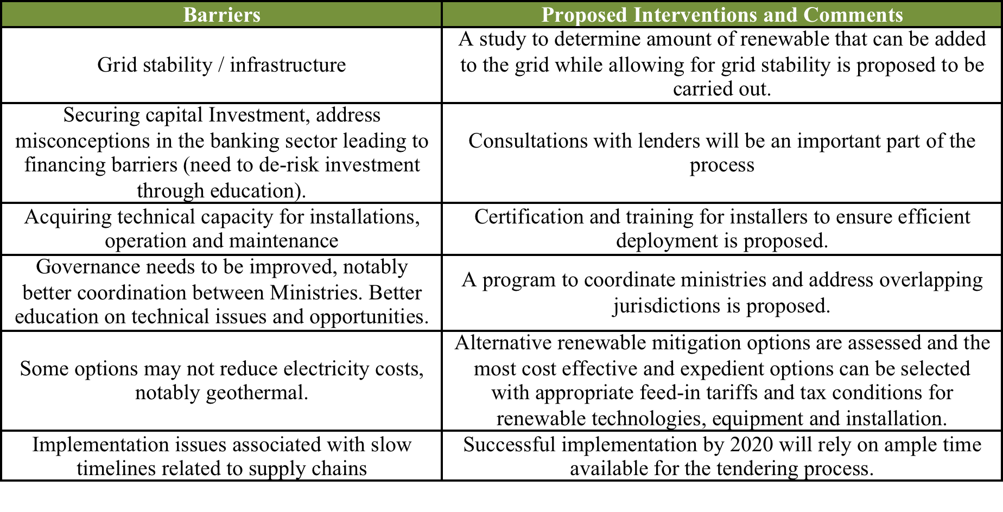
Main barriers to implementation

Slide 8
Barrier & Challenges to CDM
Institutional hurdles:
  Architecture: We have not established the institutional architecture for the CDM (Designated National Authority. Absence of mechanism to pursue CDM projects
  Capacity constraints: CC Office/Unit small. Counterpart agencies unprepared and not particularly interested ROI: Small size/economy have made returns on investment unattractive to potential investors.
Little success with bundling: Much talk about bundling of small national projects, especially in the OECS, but no further action.
KP 2nd Commitment Period issues:
  Dramatic fall in carbon prices
  Uncertainty over second commitment period for the Kyoto Protocol.

Slide 9

Energy, Science, Technology
Stocktaking of Initiatives

Slide 10
Energy Mandate
Renewable Energy target
  35% energy generation
Reduction in Consumption target
  20% in the public sector

Slide 11
POLICIES
In 2001, Saint Lucia developed a Sustainable Energy Plan that set national targets for renewable energy and energy efficiency based on existing conditions and planned projects. The plan also presented a suite of actions for achieving those targets with public and private sector participation.
In 2010, the Government of Saint Lucia approved the National Energy Policy (NEP), which provided the appropriate policy and legislative environment, to utilize greater renewable energy to the extent possible, in order to lower the cost and price volatility of electricity and to reduce Saint Lucia’s dependence on imported oil. The NEP establishes renewable energy targets of 5 percent of the electricity generated via renewable sources by 2013, 15 percent by 2015, and 30 percent by 2020; and proposes to also allow small scale renewable energy development and distributed generation.

Slide 12
DECLARATIONS
In 2012, the Government of Saint Lucia announced refined targets in line with the Barbados Declaration on Sustainable Energy for All which included a renewable energy target of 20 percent by 2020 and an energy efficiency target of 20 percent reduction in consumption in the public sector by 2020.
In 2014, recognizing the strategic progress being made in attracting investment in geothermal and wind in particular, and the corresponding changes in the regulatory environment to facilitate the de-bundling of generation from transmission and distribution, the Former Prime Minister increased this target to 35%.

Slide 13
Success Stories

Slide 14
SUPPORT TO UTILITY REGULATION COMMISSION
&
Revised Electricity Supply Act

Slide 15
National Utilities Regulatory Commission
NURC Act No. 3 of 2016
Electricity Supply Act with its (Amendment) Act No. 2 of 2016
Water and Sewerage Act (Amended and appears as a consequential Amendment in Schedule 4 of the NURC Act).
Commissioners Appointed
NWSC transitioned to NURC
Regulations
  NURC (Dispute Resolutions) Regulations
  NURC (Appeals Tribunal) Regulations

Slide 16
NEW ELECTRICITY SUPPLY SERVICES BILL

Slide 17
ELECTRICITY SUPPLY SERVICES BILL AND REGULATIONS
NO.
LEGISLATION
ACTI
STATUS
ON
1.
A new Electricity Supply Services Bill
(Task 2)
Model Licences for Lucelec
(Task 2)
Model Licence for Renewable
Energy
2.
Customer Service Standards
Regulations
3.
Wiring Regulations
4.
Electrical Licensing
(EL) Regulations
5.
Interconnection Regulations
6.
Grid Code Regulations
Report to be reviewed. NURC will
have to review Report and
implement the Grid Code where
necessary.
7.
Tariff Regulations
Currently being drafted.
8.
Network Licensee Regulations
9.
Licensing Regulations
10.
Fair Competition
Regulations
11.
Fees Regulations

Slide 18
ADDRESSING GRID STABILITY AND INFRASTRUCTURE CONCERNS

Slide 19
National Energy Transition Strategy (NETS)
Objectives:
The Saint Lucia NETS process seeks to identify the optimal set of generation, transmission, and distribution investments that will:
Improve reliability of the grid
Facilitate cost containment in an future of volatile oil prices, benefitting the electricity consumer
Support increased energy independence, including the achievement of renewable energy targets (per the National Energy Policy)

Slide 20
National Energy Transition Strategy (NETS)
Anticipated Outcome:
A plan, including a set of scenarios detailing how to integrate the optimum mix of conventional and renewable energies into the national electricity grid, at the least cost, without compromising the stability and reliability of the electricity system.
  This plan will be created jointly between Government and LUCELEC, and will be submitted to the National Utilities Regulatory Commission (NURC).
  The process will be participatory with the Stakeholder Consultation and finalizing with a Public Consultation session to present the results.

Slide 21
ENERGY EFFICIENCY

Slide 22
ENERGY EFFICIENCY BILL

Slide 23


Energy Efficiency Bill
Drafting funded through ECERA Project
The purpose of the Energy Efficiency Act is to promote Energy Efficiency and Conservation
A public consultation was held in February, 2016
Drafting of the EE Bill and Regs is currently ongoing
Notes:
Regulations:
Building renovation
Government buildings
Energy efficiency obligation schemes
Alternative measures
Energy audits and energy management systems
Metering
Billing information
Access to metering and billing information
Consumer information and empowering programme

Slide 24
ENERGY EFFICIENCY PROJECTS

Slide 25
Project Oriented Nama – Energy Efficiency
Promotion and Implementation of Lighting Retrofits
  Lighting retrofits completed at NEMO, Post Office and High Court.
  Reduction in consumption by at least 15% in each building.
Promotion of EE in the public and private sector
  Public Awareness Campaigns on Energy Efficiency
Programs to promote the establishment of Energy Management System and Energy Managers
  - Training of Energy Managers

Slide 26
Project Oriented NAMA – Energy Efficiency
Energy Audits in Public Building
Training of Auditors in different software programs
Promotion of ESCO system to assist with Energy Efficiency Retrofits

Slide 27
TRANSPORT SECTOR

Slide 28
INCENTIVES

Slide 29

INCENTIVES
Reduction in Import Duties for Electric and Hybrid Vehicles

Slide 30
DEVELOPMENT STRATEGIES
PLANS
Transitioning of Government Fleet to Hybrid and Electric Vehicles
Establishment of Solar Car Ports with Charging Stations

Slide 31
RENEWABLE ENERGY
REACHING 21MW by 2020

Slide 32
INCENTIVES

Slide 33
INCENTIVES
Import Duty waivers on Renewable Energy and Energy Efficient Equipment

Slide 34
GEOTHERMAL RESOURCE DEVELOPMENT

Slide 35
Geothermal Development ROADMAP
Upstream Resource Development
Downstream Plant Construction/Ops
Stage Key Activities
I
II
III
IV
V
RESOURCE INFORMATION GATHERING
COMPLETE LAWS AND LEGISLATION
PRE-FEASIBILITY
INITIAL ESIA
LAND CONTROL
RESOURCE CONFIRMATION
FEASIBILITY
PPA
INTERNATIONAL ESIA
FINANCING
CLOSURE
FIELD AND POWER PLANT DESIGN AND CONSTRUCTION
POWER GENERATION
O&M
Surface Reconnaissance
($1-2 mil)
Exploration
Drilling
($10-30 mil)
Production
Drilling
(~$25-40 mil)
SAGS +
Power Plant
(~$45-60 mil)
Operation + Maintenance
time

Slide 36
Summary Road Map
Surface Studies/ Resource Assessment
Agreement w/ Qualified Developer
Finalize Offtake & PPA
Finalize SAGS + PP Design
PP Operation
Mobilizing Risk Capital + mitigation support
Secure funding for production drilling
EPC Contract for SAGS + PP
Routine Maintenance
Laws & Regulations
Initial Environment/
Social Assessment incl.. LAC
International ESIA incl.. Permitting & LA
Revise International ESIA for full scale development., prmt.& LA
Manufacture and Construct SAGS + PP
E&S Monitoring and Management (ESMP)
Engage Developer & LUCELEC
Exploration Drilling & Resource Confirmation
Production Drilling
Manufacture and Construct SAGS + PP
Drilling of Make-Up Wells, as necessary
Pre-Feasibility
(Bankable)Feasibility Study
Financial Closure for SAGS + PP
Certification of PP
GO/
NO-GO
GO/
NO-GO
FINANCE
CLOSE
Y/N
COMMISSION
PP
I
II
III
IV
V
Surface Reconnaissance
($1-3 mil)
Exploration
Drilling
($20-30 mil)
Production
Drilling
(~$25-40 mil)
SAGS +
Power Plant
(~$60-75 mil)
Operation + Maintenance
Project
time

Slide 38
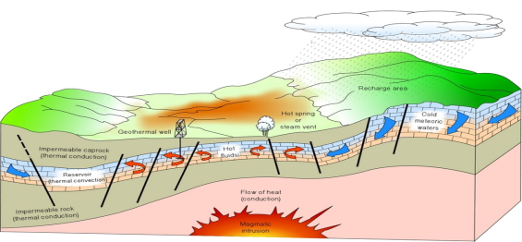
Integrated geoscience surface study
New Zealand Aid funding 1 Million USD
Implemented by Jacobs New Zealand over 8 -12 months.
Working in close collaboration with the World Bank and GoSL.
Overall objective
To identify suitable areas for
potential geothermal
exploration drilling

Slide 39
WIND ENERGY DEVELOPMENT

Slide 40
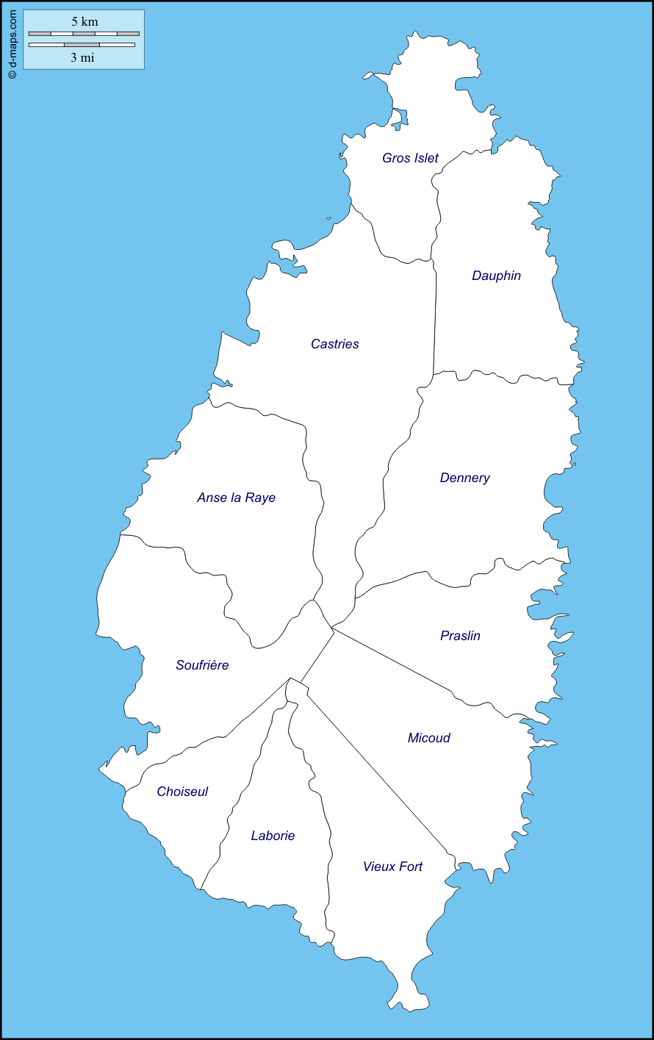
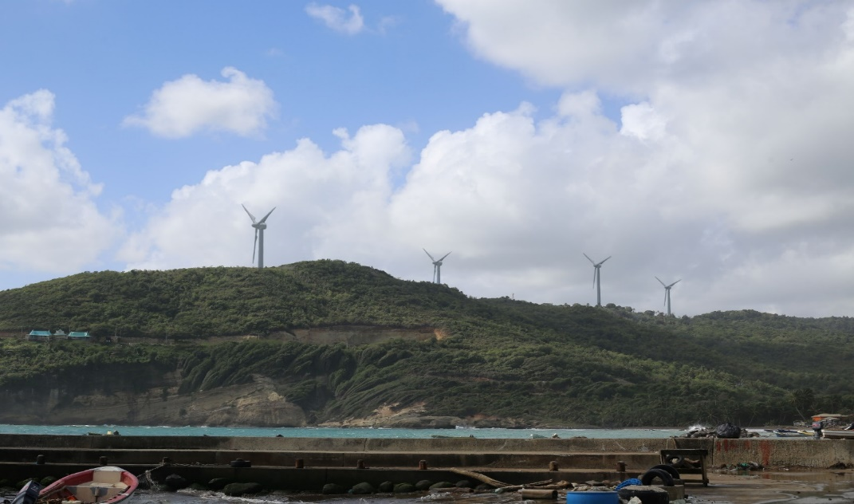
Wind
The proposed project is a 12 megawatt (MW) wind farm located in Anse Canot, Dennery on the eastern shore of St. Lucia.

Slide 41
Project Overview
The proposed project is a 12 megawatt (MW) wind farm located in Anse Canot, Dennery on the eastern shore of St. Lucia.
Four 3.0 MW wind turbines, a substation with attendant facilities, such as roads and underground electrical collection lines.

Slide 42
Current Project Status
Test tower up and over 1 year of wind data collected
Executed agreement to lease Deveaux land
GOSL agreement to lease lands
Environmental impact assessment 75% completed
Dennery community meeting was held May 18, 2016
Survey work begun

Slide 43
SOLAR PV SYSTEMS

Slide 44
Project Oriented NAMA– Renewable Energy
Installation of Distributed PV Systems on public buildings
Promotion of the use of Distributed PV Systems

Slide 45
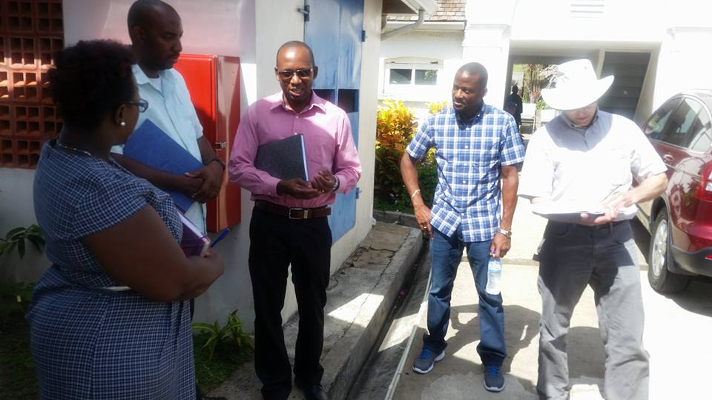
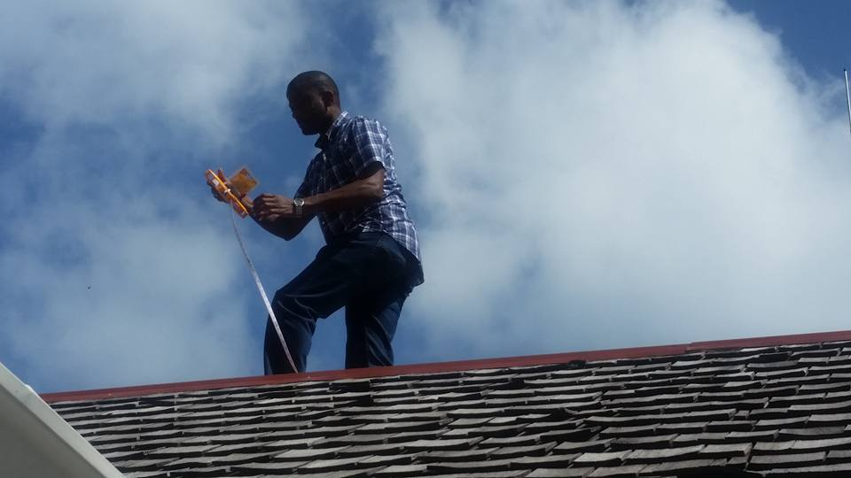
SOLAR HEADS OF STATE
International Programme responsible for the installation of Solar PV systems on the official residences of Heads of Government or State
Government House was selected as the site in St. Lucia
Designs and preparatory work for this project have been completed.
Counterpart funding in the amount of $x required from GOSL

Slide 46
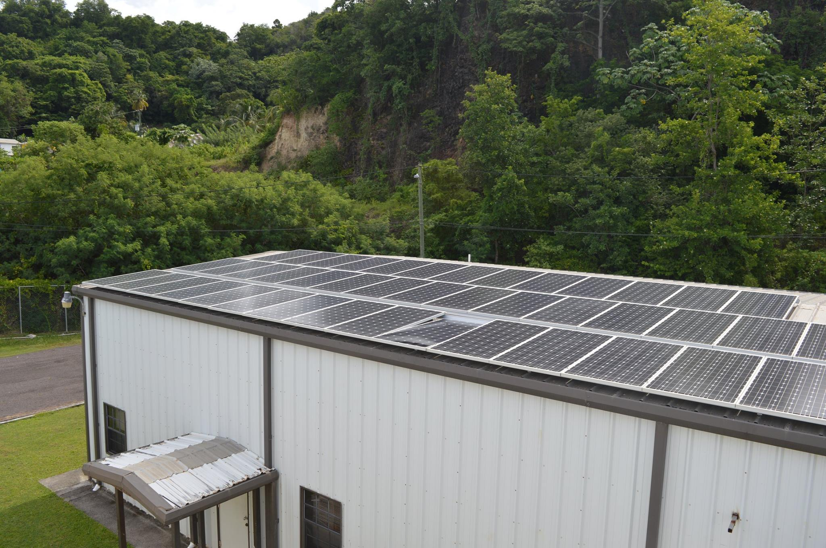
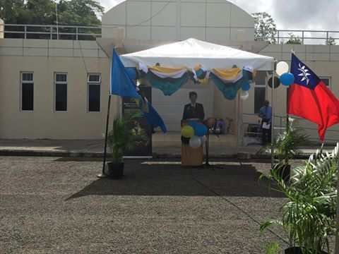
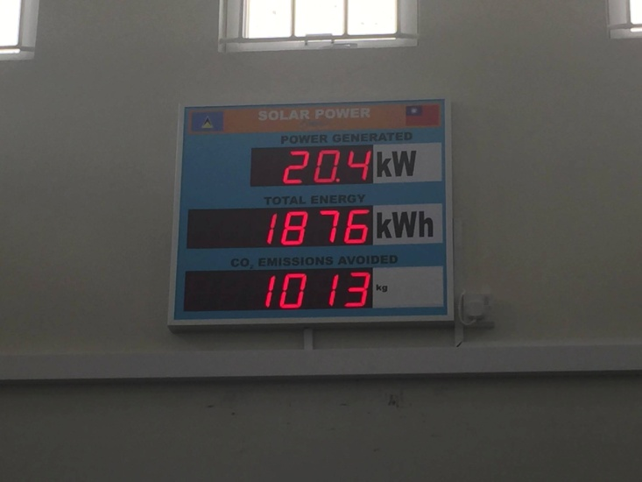
SOLAR PV SYSTEM AT NEMO
25 kW PV system installed at NEMO
Notes:
A 25kW PV system was installed at NEMO.

Slide 47
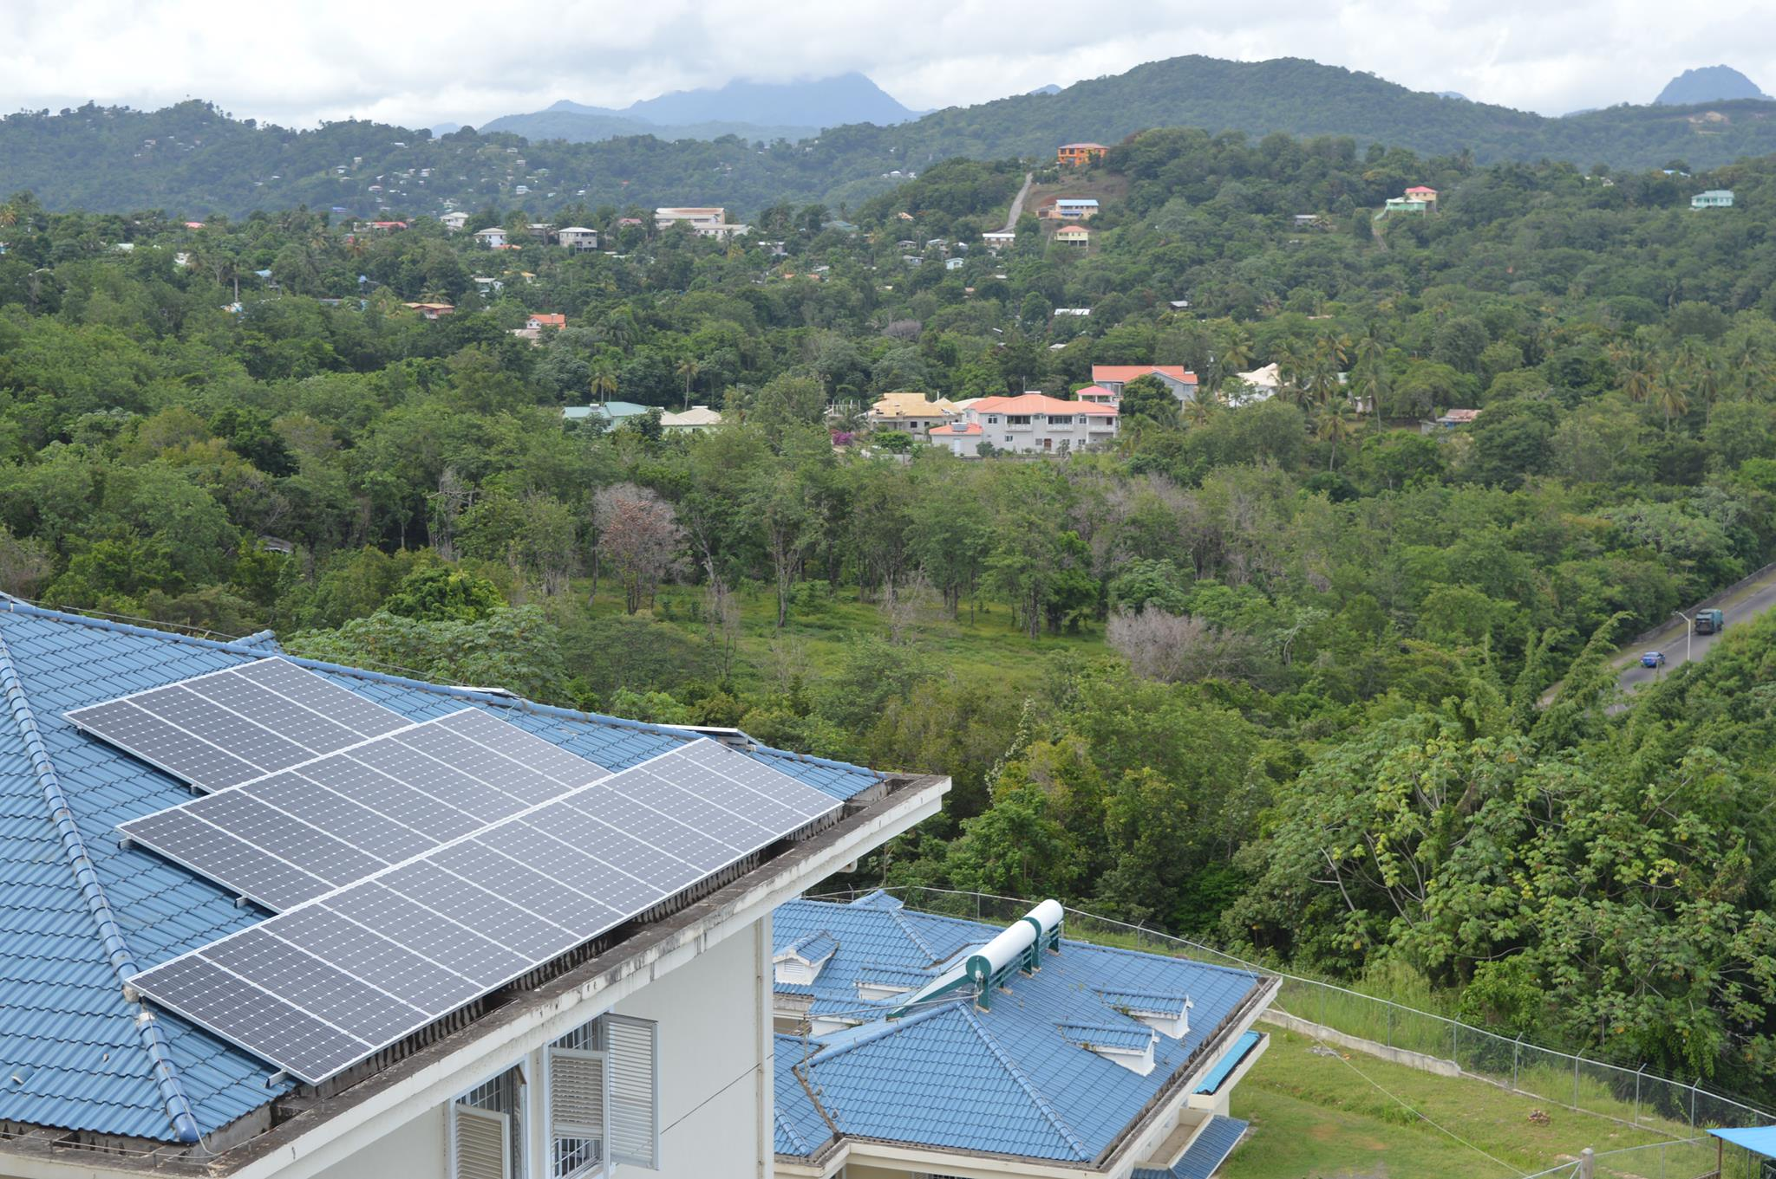
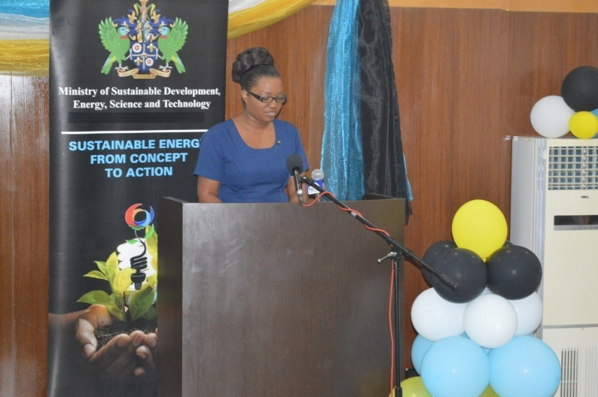
SOLAR PV SYSTEM AT NMWC
Director of NMWC speaking at press launch
PV System at NMWC

Slide 48
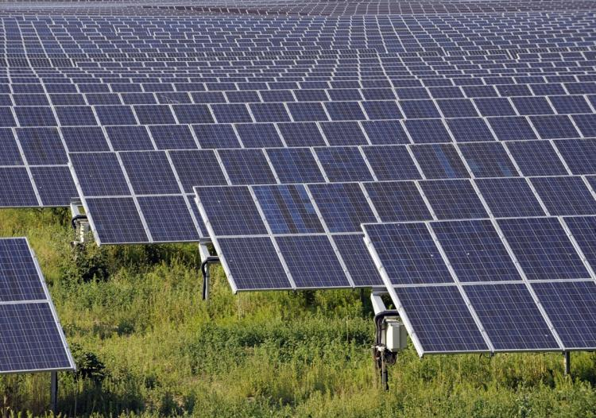
SOLAR FARM
The electric utility company with assistance from the Government of Saint Lucia through the support of CWR/CCI/RMI has begun the development a 3MW Solar Farm in Vieux Fort.

Slide 49
Other PV Projects
Marchand Community Centre
Pigeon Island National Landmark
St. Jude’s Hospital
Other Governments Buildings – presently being assessed

Slide 50
SOLAR DRYERS
Solar Dryers
  Agro processing
  Reduction in the use of LPG

Slide 51
CHALLENGES
GOVERNMENT WILL
Time frame for NURC to be become fully operational
Limitation with Grid Infrastructure
Monitoring and Evaluation of Programmes

Slide 52
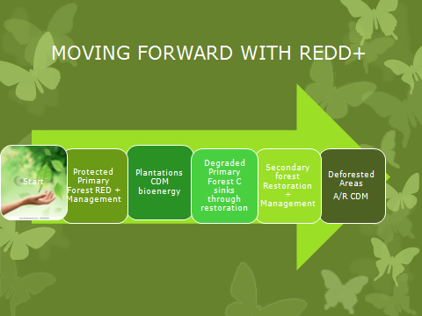

Slide 53

Challenges
Shortfall in climate change mainstreaming and government policies. Investment needs to be made in research mitigation ambition of Saint Lucia’s forests; that is all type of forests and trees outside of forests.

Slide 54
Challenges
Need for capacity building and strengthen national understanding and support for forest REDD+ initiatives, with special attention to the contribution of forests in climate change mitigation
.

Slide 55
Challenges
Needs a shift in focus to see forests and forest peoples as assets rather than as a state resource to be protected from the people

Slide 56
Challenges
Needs to foster the development of civil society organizations and local experts capacity to lobbying for sustainable forest management and financing

Slide 57
MITIGATION efforts require a collaborative effort involving multiple stakeholders
Thank you!

